Slide 1
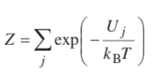


Atomistic Solution Models
Consider a system with N interacting particles and a number of energy states numbered with the j index
Partition Function
A = -k_{B}T ln(Z)
Relative to T = 0K
Energy states will be degenerate, that is more than one state can have the same energy, then,

Slide 2

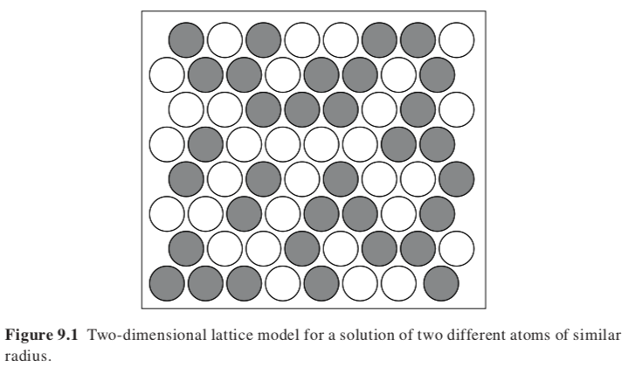



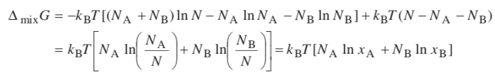
Ideal Solution Model
Sterling’s Approximation

Slide 3



Ideal Solution Model

Slide 4




Regular Solution Model
Coordination number ”z” z = 6 for Cartesian Coordinates
N_{AA} = number of A-A contacts with an energy of u_{AA}
Lattice has N sites
Total number of pairs is zN/2
Average energy of pure A is U_{A} = zN_{A}u_{AA}/2
For A atoms there are zN_{A} pairwise interactions made up of 2 interactions for each A and one for each AB

Slide 5





Regular Solution Model

Slide 6





Regular Solution Model
µ_{A} ~ dG/dx_{A}

Slide 7
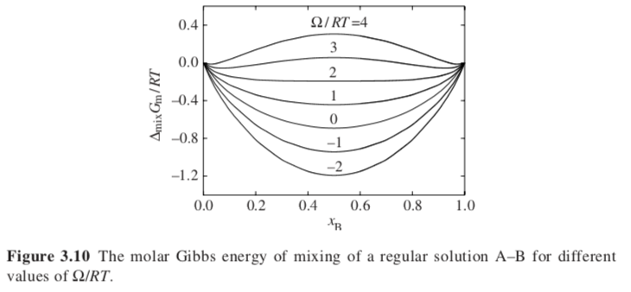

Slide 8
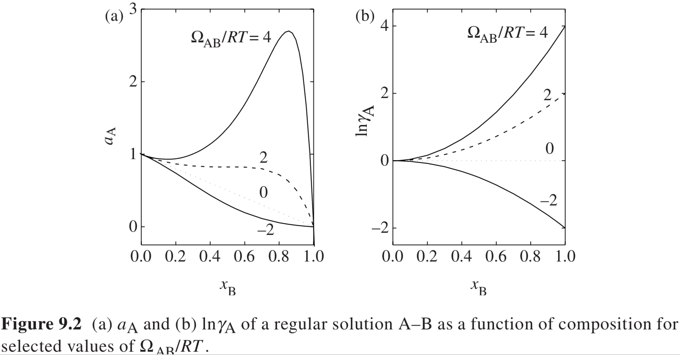


$$a_{A}=exp\left[ln\left(1−x_{B}\right)+Ω_{AB}x_{B}^{2}\right]$$
$$γ_{A}=exp\left[\frac{Ω_{AB}x_{B}^{2}}{RT}\right]$$

Slide 9
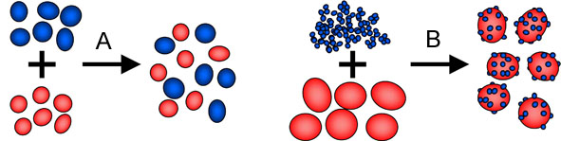

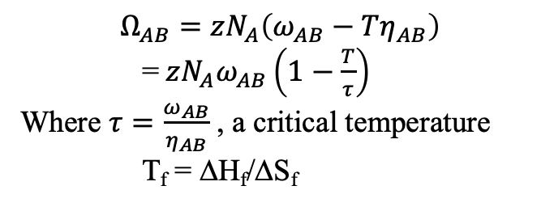
Entropy of Mixing
$$Ω_{AB}=zN_{A}ω_{AB}$$
A) Here we consider a combinatorial entropy of mixing and a binary enthalpy of mixing
B) A change in organization can also occur which leads to an additional entropic term
$$Ω_{AB}=zN_{A}\left(ω_{AB}−Tη_{AB}\right)$$
= $zN_{A}ω_{AB}\left(1−\frac{T}{τ}\right)$
Where $τ=\frac{ω_{AB}}{η_{AB}}$ , a critical temperature
T_{f} = ΔH_{f}/ΔS_{f}

Slide 10




Vibrational Contribution
With vibrational part
G_{A}=N_{A}lnZ_{A} = lnZ_{A}^{NA}
Z_{A} is vibrational partition function of A
U’ is internal energy minus vibrational part
G = H –TS so last term is the non-configurational (non-combinatorial) entropic terms
Hildebrandt type parameter for vibrational contributions

Slide 11


Excess molar Gibbs energy of mixing for quasi-regular solution
G = H –TS so first term is enthalpic, second is entropic
τ is a characteristic temperature, when T = τ ideal solution behavior is seen

Slide 12
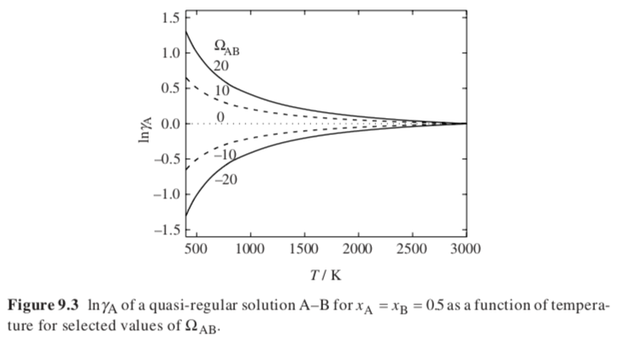
For Positive Ω
T = τ Ideal
T > τ Mix
T < τ Demix
For Negative Ω
T = τ Ideal
T > τ Demix
T < τ Mix
For Ω = 0
Ideal

Slide 13
For Positive Ω
T = τ Ideal
T > τ Mix
T < τ Demix
~ Ω/kT
~A + B/T
A positive B positive Demix
A negative B negative Mix
A negative B positive UCST
A positive B negative LCST
For Negative Ω
T = τ Ideal
T > τ Demix
T < τ Mix
For Ω = 0
Ideal

Slide 14
Mean Field (what we have considered) Interactions are random, there is no structuring
Specific Interactions Interactions are not random, there is identity between interacting pairs
Coulombic Interaction for instance

Slide 15
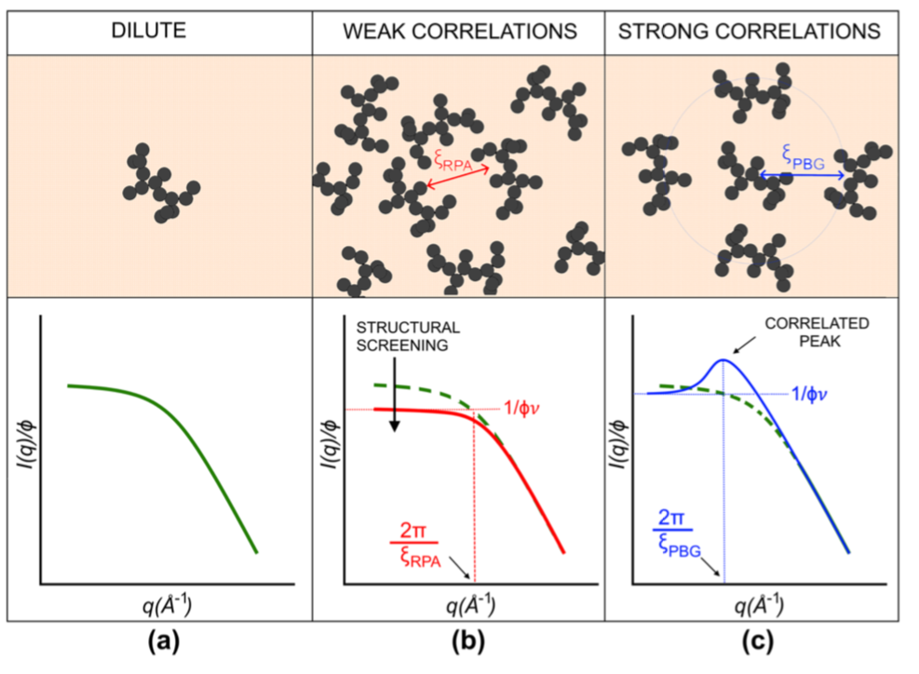
Correlations
Dilute: Ideal behavior, there are no interactions
Semi-dilute: weak or strong interactions are possible
With weak interactions the system can be treated with a “mean field”. No correlation is observed, we can use the second virial coefficient and Hildebrand Model
With strong interactions we need to use detailed information about interactions, correlation function or other models

Slide 16

Virial Coefficient Approach for Weak Interactions (Mean Field)
Consider that two materials mix, A is matrix and B is diluent
B behaves like an ideal gas in A when B is dilute
P = ρRT
The presence of B creates a pressure called an osmotic pressure Π
This pressure can be measured for particles in a solution such as proteins in water
At higher concentrations with a mean-field we can use a virial expansion to describe the pressure
= ρRT(1 + A₂ ρ + A₃ ρ² + A₄ ρ³ + …) Where A₂ is the second virial coefficient and reflects binary interactions in a mean field
By comparison with the Van der Waals equation of state where v = 1/ρ
A₂ = b – a/RT where “b” is the “excluded volume” and “a” is the attractive interaction potential for B’s
P/ρ = energy ~ ρRT A₂ = ρ(RT b – a)

Slide 17
Virial Coefficient Approach for Weak Interactions (Mean Field)
P/ρ = energy ~ ρRT A₂ = ρ(RT b – a)
Dilute: Ideal behavior, there are no interactions
Semi-Dilute
A₂ = 0 Ideal/critical point
A₂ > 0 Miscible
A₂ < 0 Immiscible
T = a/(bR) Ideal
T < a/bT Miscible
T > a/bT Immiscible
Dilute: Ideal behavior, there are no interactions
Semi-dilute
Ω = 0 Ideal
< 0 Miscible
> 0 Immiscible
T = τ Ideal
T > τ Miscible
T < τ Immiscible

Slide 18

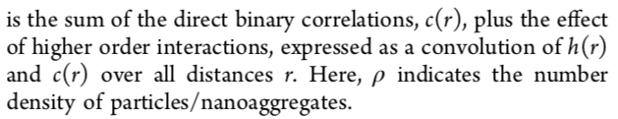
A. How to deal with more than (h(r) or g(r)) binary interactions c(r)
Correlation Function, h(r)
A recursive relationship.
Requires a closure relationship to find a solution.
Closure relationships: Random Phase Approximation (RPA) ρ => 0
Percus-Yevick Approximation (complex)
Born-Green Approximation (simpler)

Slide 19

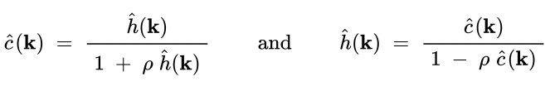
Strong Interactions (Specific Interactions)
Correlation Function, h(r)
A recursive relationship.
Requires a closure relationship to find a solution.
Fourier transform of the OZ function; a convolution becomes a product.
Fourier Transform of a structural correlation function is the scattered intensity which is composed of a form factor F²(q) and a structure factor S(q). If we measure a dilute system with no correlations I₀(q) and if
I(q) = S(q) F²(q) = S(q) I₀(q) (φ/φ₀)
We can assume a model for c(k) and calculate S(q) = I(q)/I₀(q) (φ₀/φ) Structure factor (the peak part of scattering)

Slide 20
Correlations
Dilute: Ideal behavior, there are no interactions
Semi-dilute: weak or strong interactions are possible
With weak interactions the system can be treated with a “mean field”. No correlation is observed, we can use the second virial coefficient and Hildebrand Model
With strong interactions we need to use detailed information about interactions, correlation function or other models

Slide 21
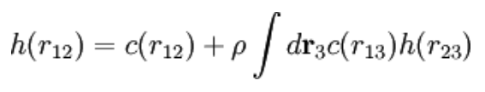




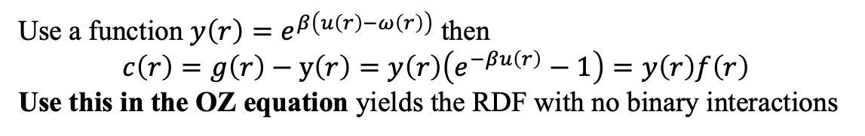
Strong Interactions (Specific Interactions)
Correlation Function, h(r)
A recursive relationship.
Requires a closure relationship to find a solution.
Percus-Yevick Approximation Closure.
Binary correlation
Correlation fun. without direct interactions
Binary RDF = Total RDF - RDF with no binary interaction
g(r) or h(r)
Use a function $y\left(r\right)=e^{β\left(u\left(r\right)−ω\left(r\right)\right)}$ then
$$c\left(r\right)=g\left(r\right)−y\left(r\right)=y\left(r\right)\left(e^{−βu\left(r\right)}−1\right)=y\left(r\right)f\left(r\right)$$
Use this in the OZ equation yields the RDF with no binary interactions
g(r) = h(r)
https://www.chemeurope.com/en/encyclopedia/Percus-Yevick_approximation.html

Slide 22





B. How to deal with more than binary interactions
BBGKY hierarchy (Bogoliubov-Born-Green-Kirkwood-Yvon)
Probability density function in position, q_{i}, and momentum, p_{i}, per particle
Liouville Equation
Force acting on particle ”i”
Integrate the Liouville Equation yields a chain of equations relating binary interactions with ternary interactions; ternary interactions with quaternary interactions etc. This cannot be solved unless a model is used for f_{s+1}.

Slide 23




Strong Interactions (Specific Interactions)
Correlation Function, h(r)
A recursive relationship.
Requires a closure relationship to find a solution.
Closure relationships: Random Phase Approximation (RPA) ρ => 0
Percus-Yevick Approximation; Born-Green Approximation
g(r) = h(r)
P = ρRT(1 + A₂ ρ + A₃ ρ² + A₄ ρ³ + …)
For a square well potential: A₂

Slide 24
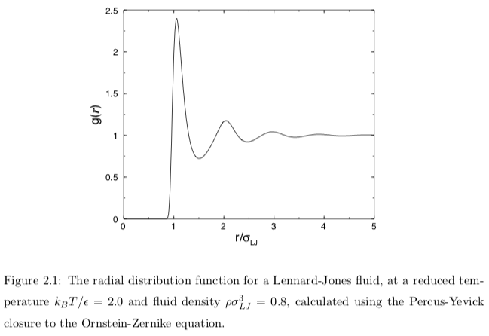
Strong Interactions

Slide 25
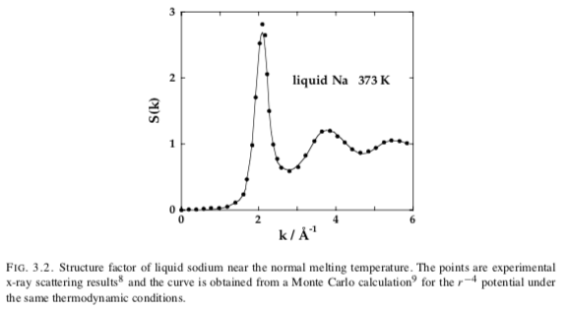
S(q) = φ₀I(q)/(φI₀(q)) Structure factor

Slide 26
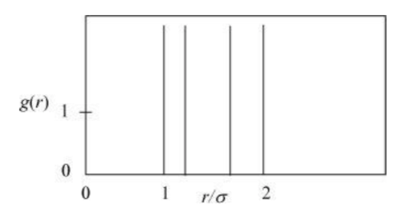
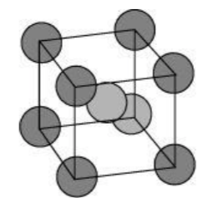
Strong Interactions
Center Atom
Face Diagonal Atom
Side Atom
Body Diagonal Atom

Slide 27
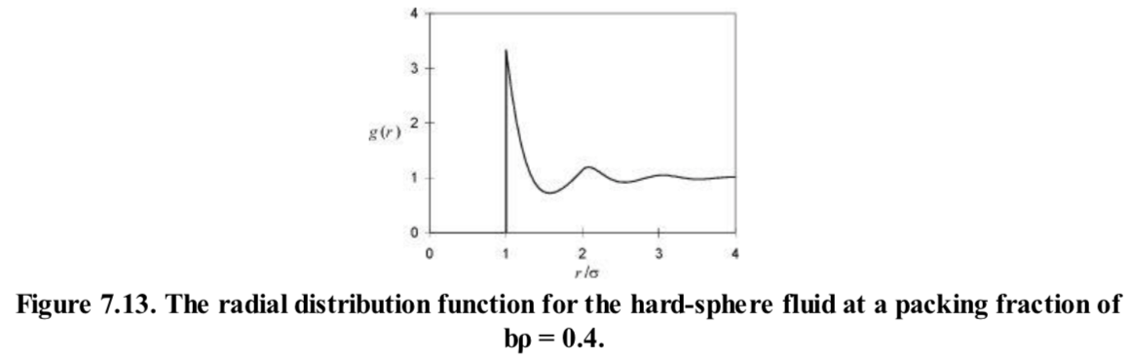
Strong Interactions

Slide 28
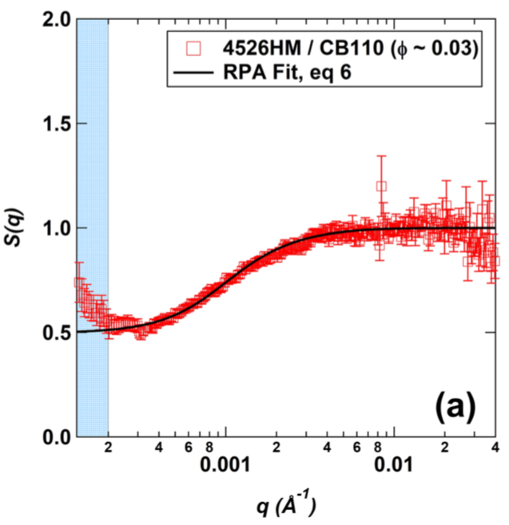
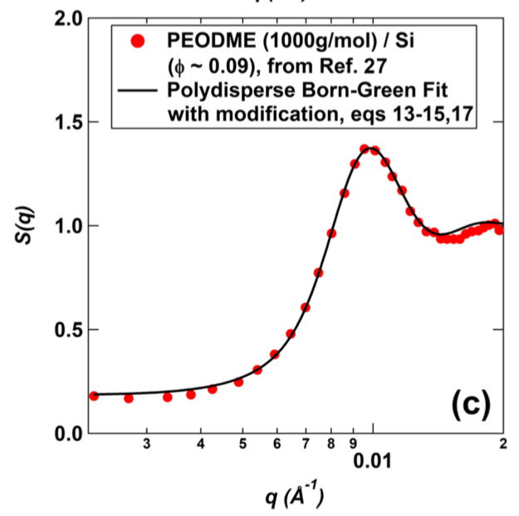
Weak Interactions
Strong Interactions
I(q,φ) = I(q,φ₀) S(q,φ) φ/φ₀
A₂ ~ ν

Slide 29
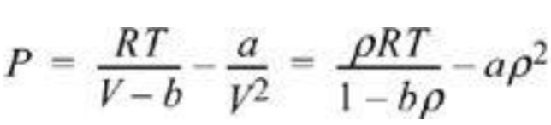
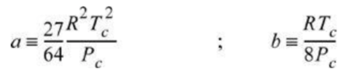
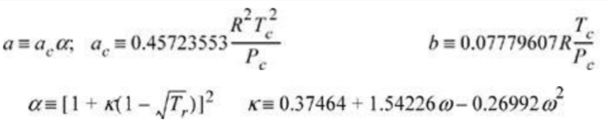



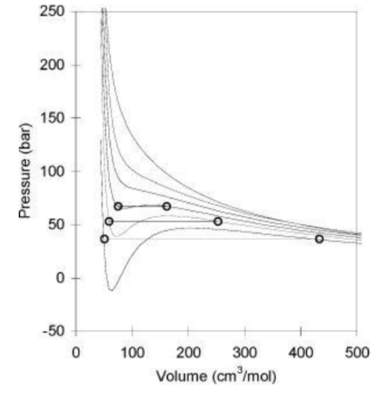
Models for Interactions Based on a Mean Field Approach
There are many models, the book mentions the Quasi-Chemical Model which is used in Calphad and ThermoCalc
Elliot and Lira give a reasonable discussion of various models in Chapters 7, 11, 12
Chapter 7
Van der Waals: Includes excluded volume, ”b”, and attractive interaction “a”
Peng-Robinson: Attractive interaction term is more complicated and includes the acentric factor ω. ”a” has a temperature dependence.
These equations have a cubic form:

Slide 30
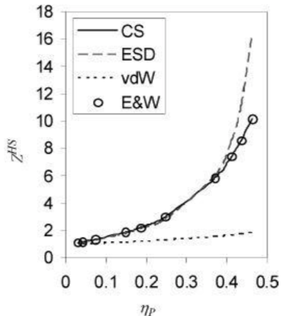
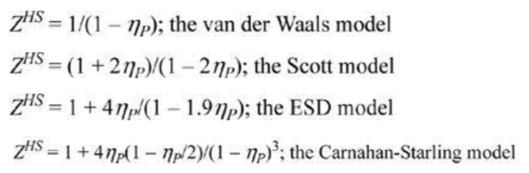
Hard core model for Van der Waals
Compare with Molecular Dynamics (o) for Hard Spheres E&W
Z = PV/RT = 1/(1-bρ) – (a/RT) ρ
Hard core no attractive interaction, η_{P} = bρ

Slide 31


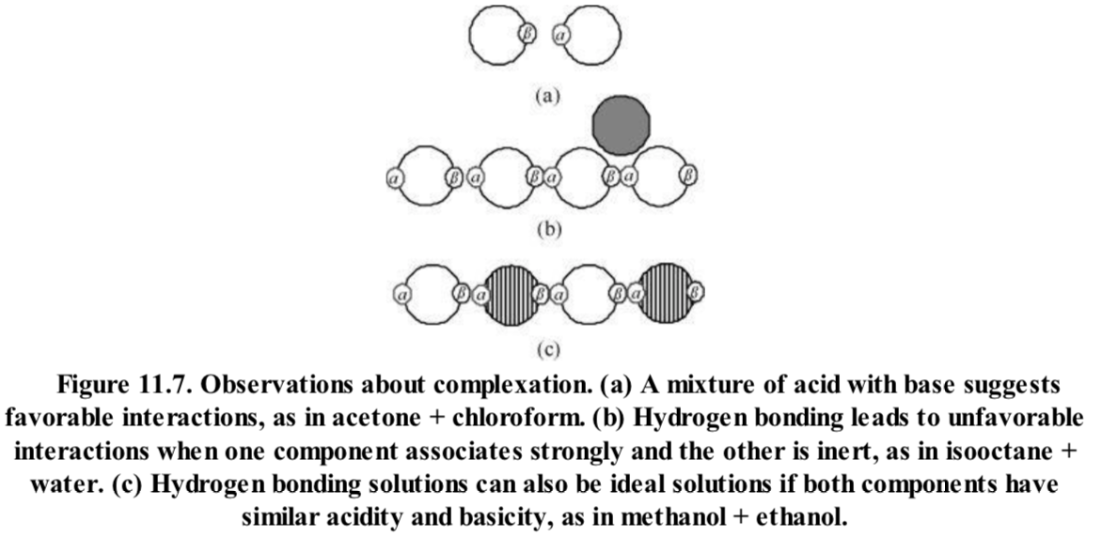

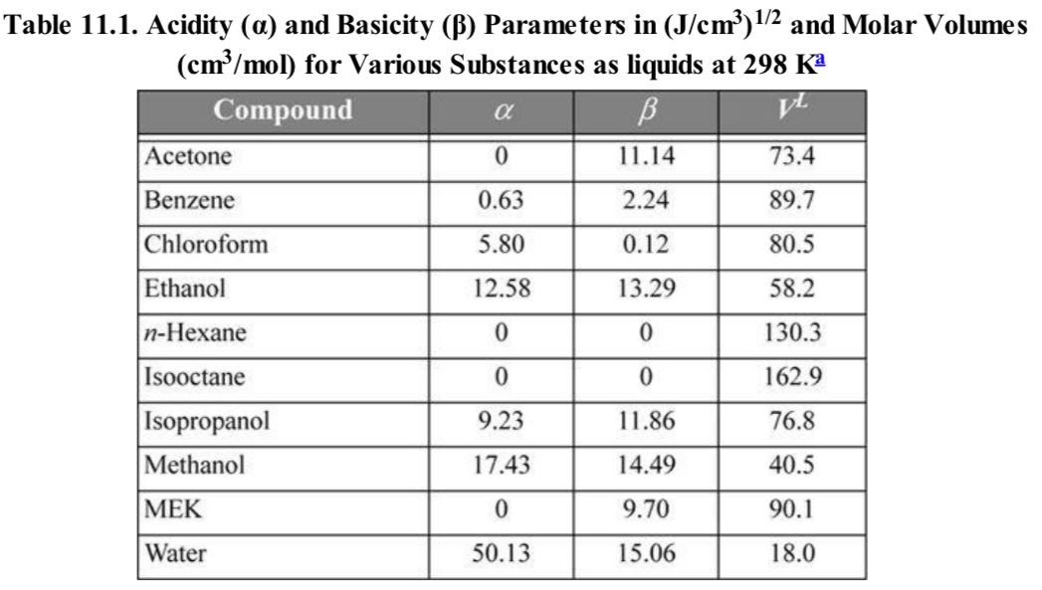
Chapter 11 Elliot and Lira
Margulis one-parameter Model
Hildebrand Model
Margulis acid-base Model

Slide 32








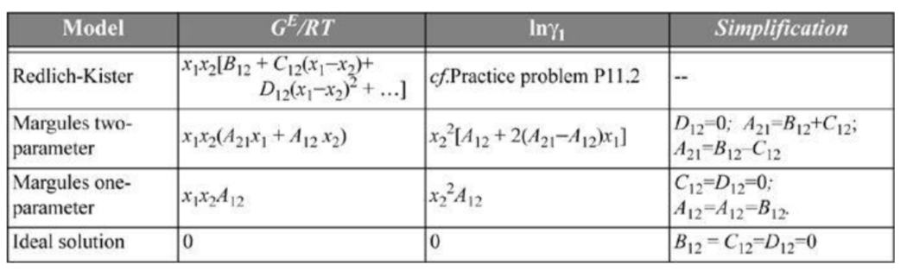
Redlich-Kister Model (asymmetric phase diagrams)
Two-parameter Margulis Model

Slide 33

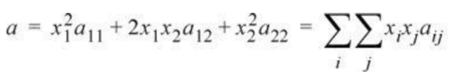




Van der Waals Models
Consider 11, 22, and 12 interactions
Regular Solution Models
-SUV
H A
-pGT
G = H – ST
H = U + PV
So
G = U + PV – TS
(A = U – TS)
For Symmetric Mean-Field Models there are two main problems, organizational entropy change on mixing and changes in volume on mixing
Ignore PV which is small G ~ A
If V ~ S ~ 0 then G = U
This is a regular solution
Van Laar Model
Consider Lattice sites do not have the same volume, V₁, V₂

Slide 34
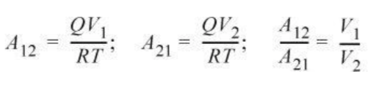

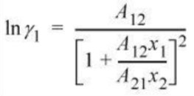
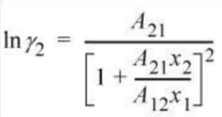
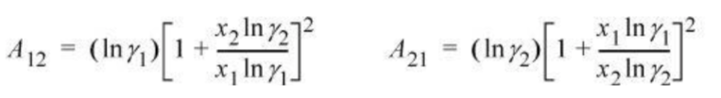
Van Laar Model
Include asymmetry

Slide 35


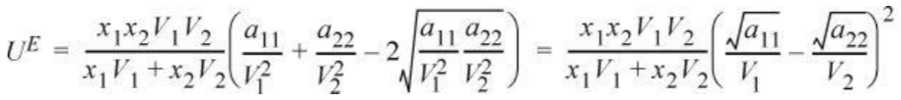


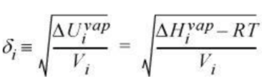

Scatchard-Hildebrand Theory
Theory based on Volume Fraction rather than Mole Fraction
δ = Solubility Parameter
Volume Fraction
U = H – PV
Cohesive Energy Density

Slide 36
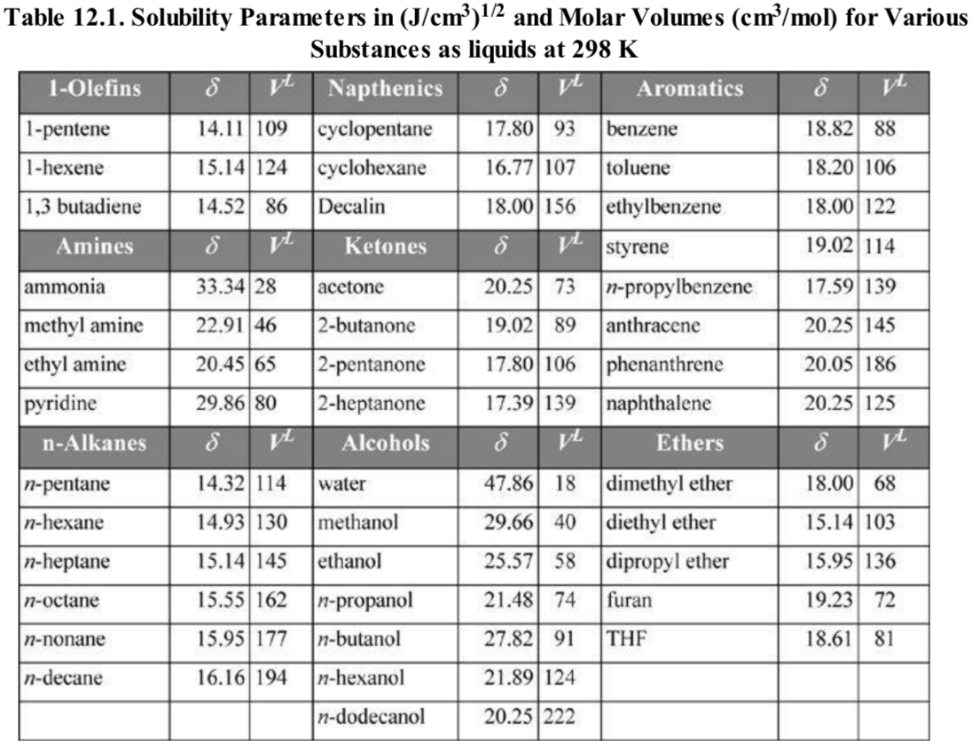

Slide 37



Scatchard-Hildebrand Theory

Slide 38



Scatchard-Hildebrand with Adjustable Parameter

Slide 39
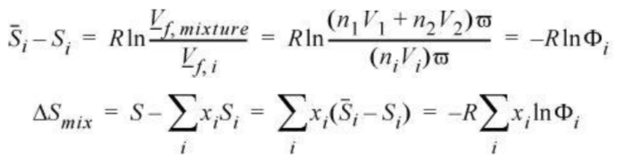
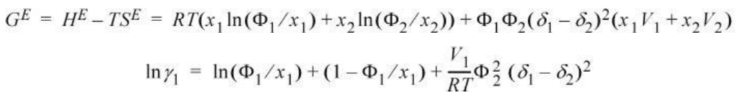

Flory-Huggins Model for Polymers
Point Masses have no volume
Real molecules have excluded volume
Only the available volume can be used to mix so the entropy of mixing should be modified
ω accounts for the available volume

Slide 40

Flory-Huggins Model for Polymers
r = V₂/V₁ 2 is polymer

Slide 41
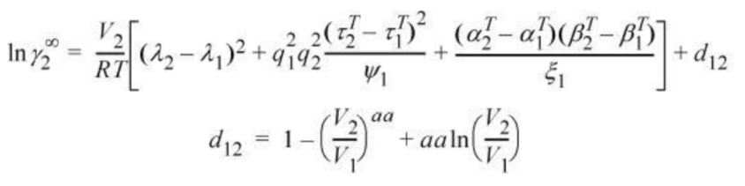
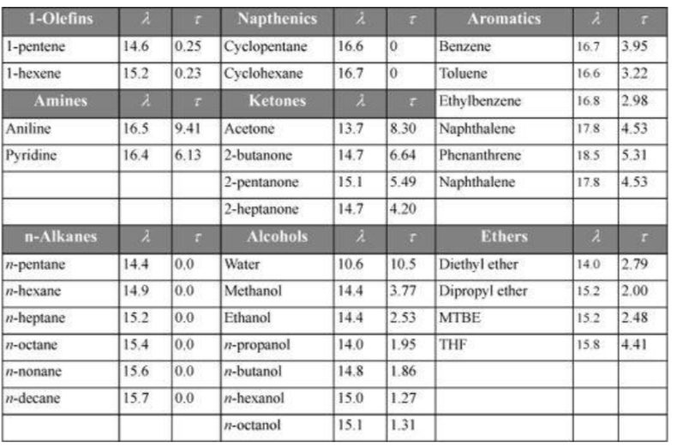
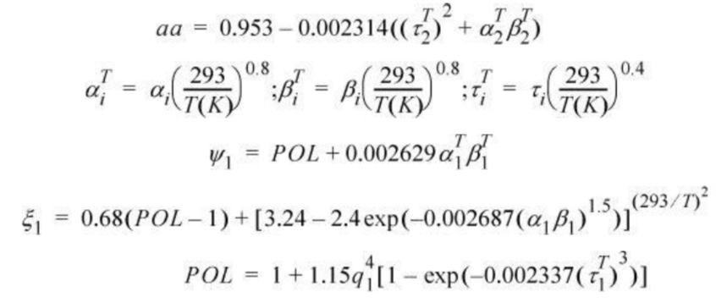
Account for Hydrogen Bonding
MOSCED Model (MOdified Separation of Cohesive Energy Density)
Calculates the infinite dilution activity coefficient
This is used in another model to fit parameters at infinite dilution to the MOSCED model
Such as Redlich-Kister, van Laar, or below
λ_{i} dispersion factor
τ_{i} is the polarity
q_{i} is .9 to 1

Slide 42




Account for Hydrogen Bonding
SSCED Model (Simplified Separation of Cohesive Energy Density)

Slide 43
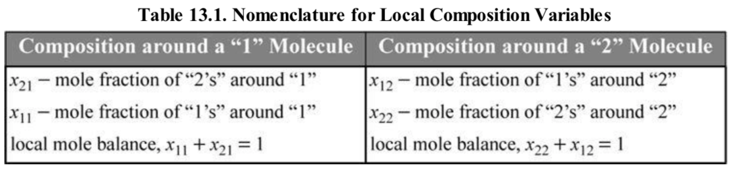
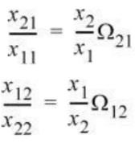
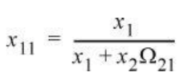


Local Clustering Models

Slide 44



Local Clustering Models
For Pure components

Slide 45




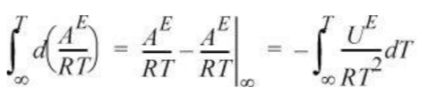
Local Clustering Models
To obtain Helmholz Free energy use
Need an expression for Ω as a function of temperature

Slide 46
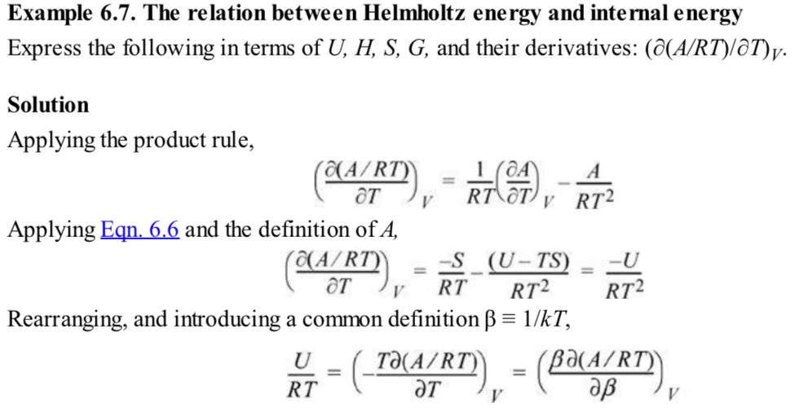

Slide 47
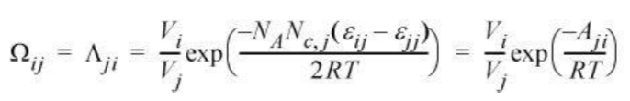
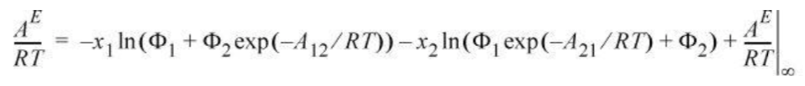
Wilson’s Equation
Temperature dependence of Ω
Temperature dependence of Ω
Two activation energies 1 around 2 and 2 around 1
Assume G ~ A (PV is insignificant)
Break G into a residual (energetic) contribution that vanishes at T => ∞ and a combinatorial (size and shape) contribution

Slide 48

Wilson’s Equation
Temperature dependence of Ω
Two activation energies 1 around 2 and 2 around 1
Assume G ~ A (PV is insignificant)
Break G into a residual (energetic) contribution that vanishes at T => ∞ and a combinatorial (size and shape) contribution
Use Flory’s expression for the combinatorial contribution

Slide 49






Wilson’s Equation
Temperature dependence of Ω

Slide 50






Non-Random Two Liquid Model (NRTL)
G = U + PV –ST if you ignore PV and ST and say G ~ U then an integration isn’t needed

Slide 51





Universal Quasi-Chemical Model (UNIQUAC)
Temperature dependence of Ω depends on surface area rather than volume
Interactions occur at surfaces q_{i} ~ surface area of component ”i”
Surface Area Fraction
Last term accounts for non-spherical surface area effects on mixing (branched chains)

Slide 52


Guggenheim Modification to Universal Quasi-Chemical Model (UNIQUAC)
r is volume ratio, q is surface area ratio
Both obtained from group contribution method

Slide 53


Slide 54


Universal Functional Activity Coefficient Model (UNIFAC)
Combinatorial term same as UNIQUAC (surface area based)
Residual term involves group contribution rather than whole molecule

Slide 55

Solutions with multiple sub-lattices
NaCl-KBr or Spinels AB₂O₄
Disorder in the placement of Na+ and K+
And Cl- and Br- leads to entropy
Octahedral sublattice
Tetrahedral sublattice
Cation sublattice
Anion sublattice

Slide 56



Solutions with multiple sub-lattices
Ideal Solution Model (Temkin Model)
Cations surrounded by anions in crystal and in the melt
Quasi-lattice approach
Random mixing of cations and anions on their respective sub-lattices
Consider a system AC and BC

Slide 57





Solutions with multiple sub-lattices
Regular Solution Model (Temkin Model)
Need to account for next nearest neighbor interactions since nearest neighbor interactions do not change, that is Na+ Cl- interactions, you need Na+ K+ interactions
There are ½ zN nearest neighbor as well as next nearest neighbor interactions
Same as for regular solution

Slide 58






Solutions with multiple sub-lattices
Same as for regular solution

Slide 59



Bragg and Williams
Order-disorder systems
σ = Order parameter a number that goes from 0 for disordered to 1 for ordered
Convergent ordering occurs when two lattice sites are equivalent in the disordered state and crystallographically distinct in the ordered state
This occurs in solid solutions
Bragg and Williams
Solution of A and B with lattice sites a and b
AB forms at low temperatures A at a sites is ½ (1 + σ)
N_{A} + N_{B} = 2N zN interactions
Disordered State
Regular Solution
σ = Order parameter

Slide 60



Bragg and Williams
Order-disorder systems
Regular Solution
Disordered State
H = U + PV
Ideal Solution

Slide 61

Bragg and Williams
Second Order Transition

Slide 62

Bragg and Williams
Order-disorder systems
Non-Convergent ordering occurs when two lattice sites are distinct in the disordered state and distinct in the ordered state
Spinels: One tetrahedral and two octahedral cations AB₂O₄
A can be in tetrahedral or octahedral sites
Normal Spinel x = 0
Inverse Spinel x = 1
Random Spinel x = 2/3
S = 0 for x = 0 Regular Spinel

Slide 63

Ordered and Regular Spinels disorder at high temperature to increase entropy

Slide 64



For a Normal Spinel the disordering process is:

Slide 65





Non-stoichiometric Compounds
Mass-action law treatment of defect equilibria
A open circles 12
Black B 6
Grey O
Perovskite type oxide
Three sublattices
A 12 coordination
B 6 coordination number
O
O and vacancies on the O lattice randomly arranged
B atoms are reduced by oxygen vacancies

Slide 66




Non-stoichiometric Compounds
Solid Solution Approach
Sum over all vibrational states “s”
Over all configurations “c”
Configurations with degeneracy g_{c} and Gibbs energy of formation Δ_{f}G_{c}
Proposition: A perovskite ABO_{3-δ} is made up of ABO₃ and ABO_{2.5} in an ideal solution (no defect defect interactions)

Slide 67




Slide 68


